Slide 1

Spring Boot project

Slide 2
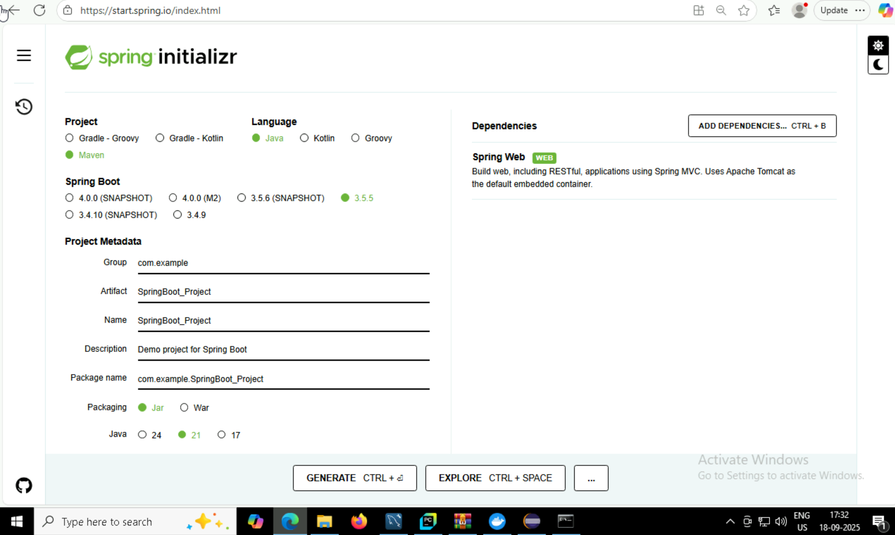
Generating Jar File

Slide 3
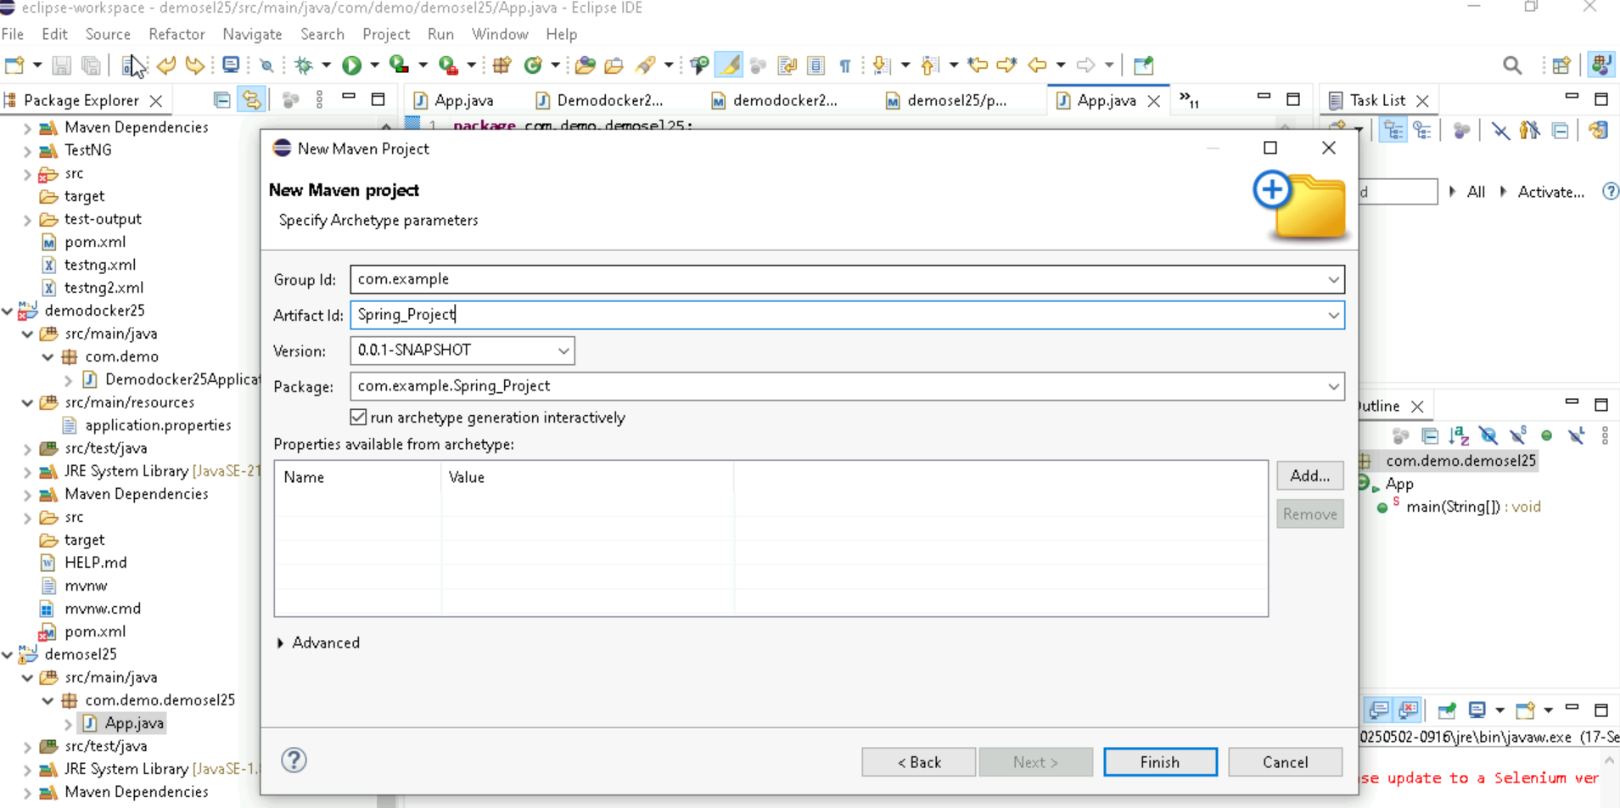
Creating Maven Project

Slide 4
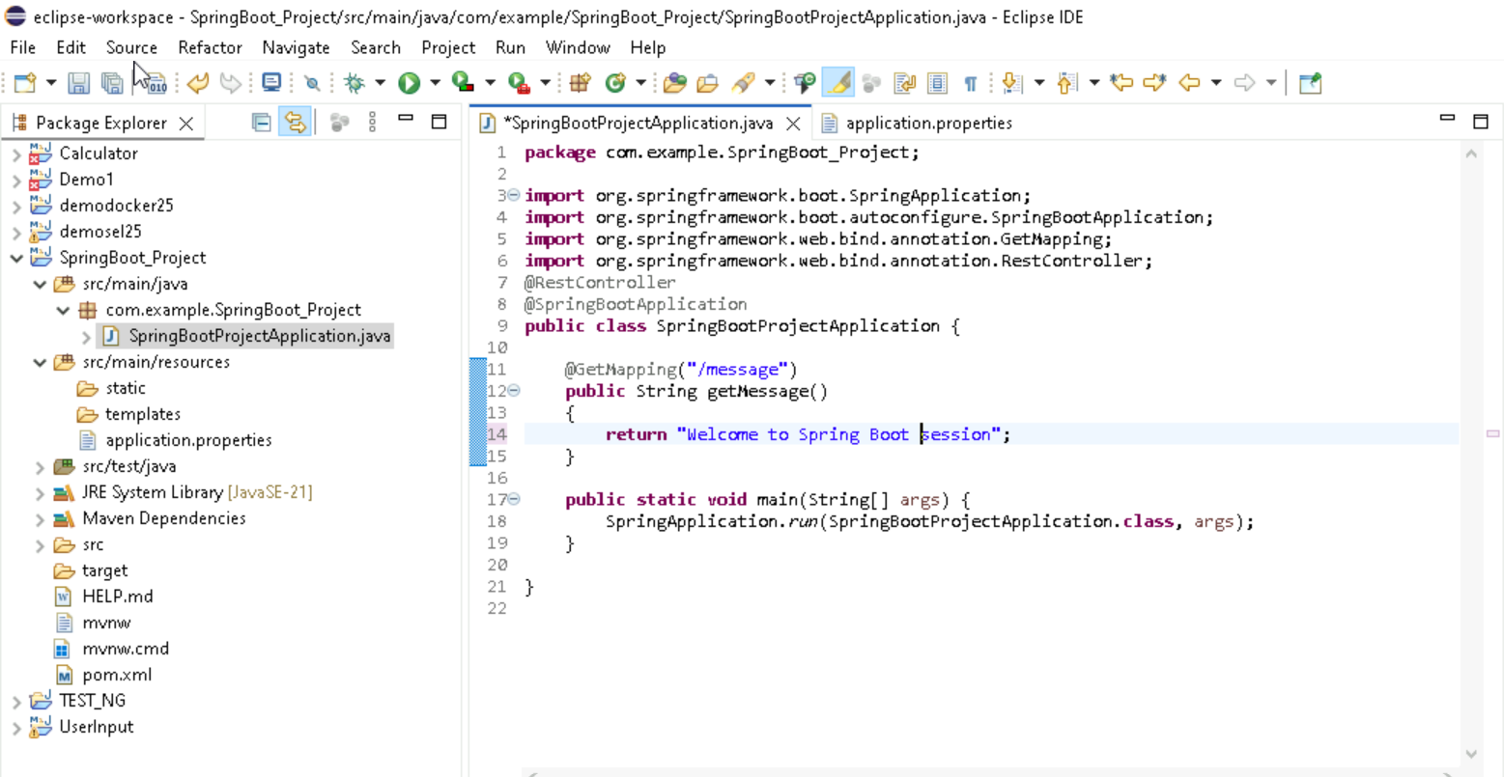
Creating A Spring Boot Application By Using Api

Slide 5
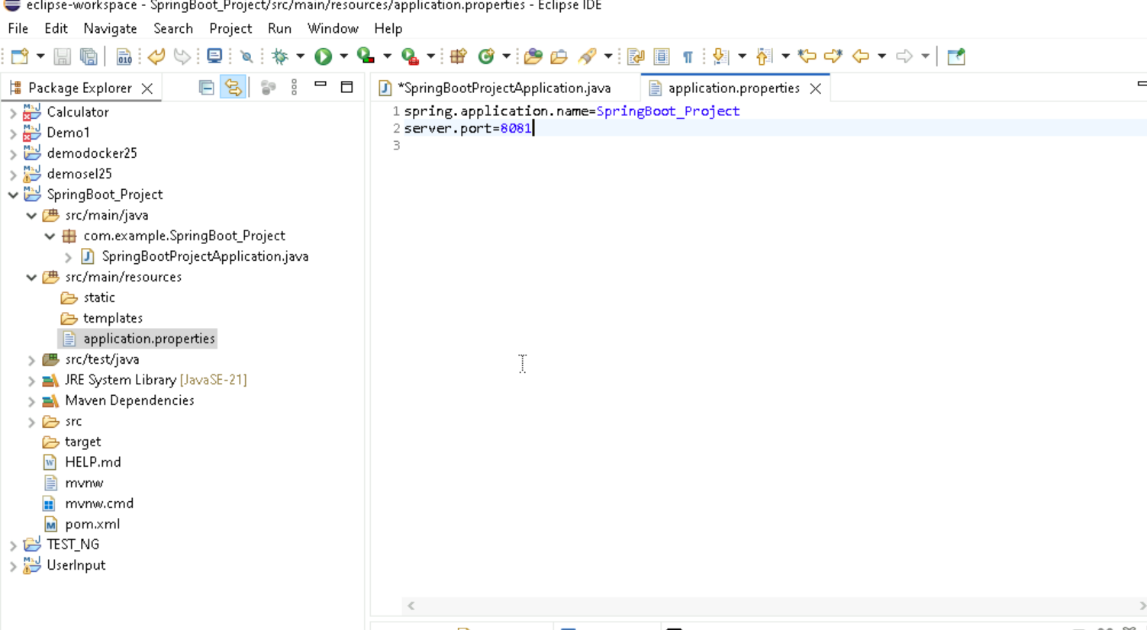
Making Changes in Application.properties

Slide 6
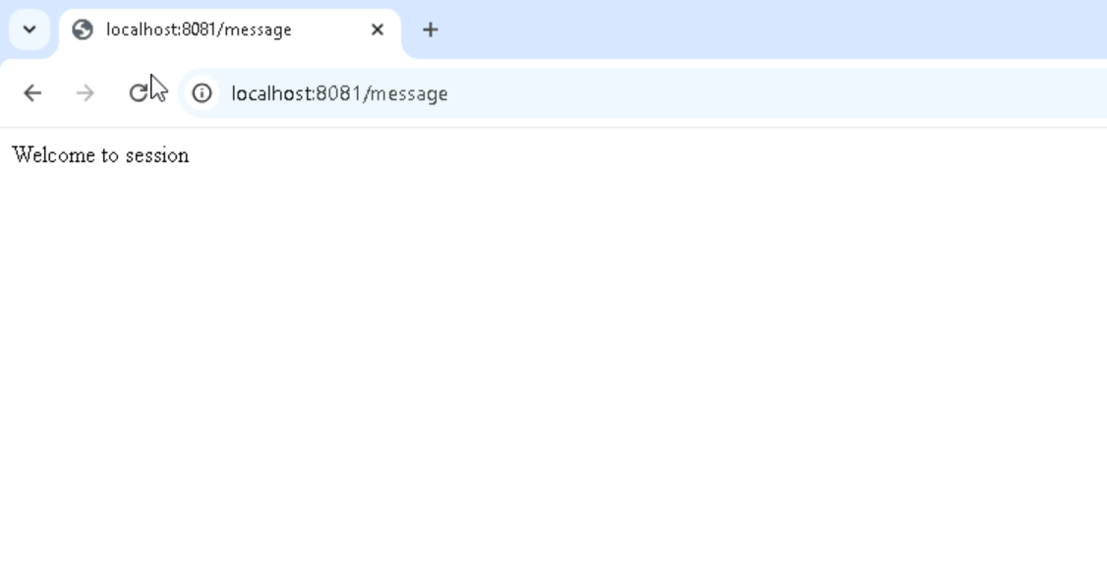
Output

Slide 7
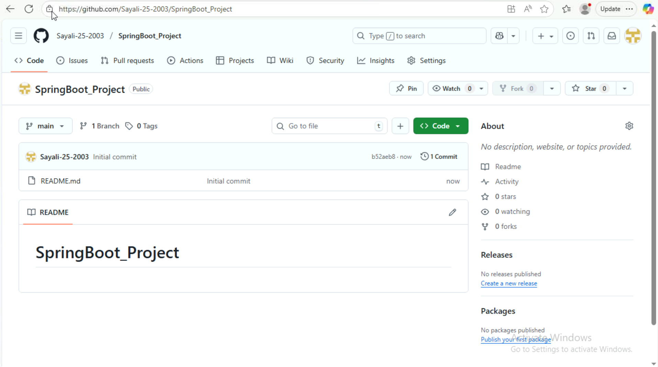
Making A Repository In GitHub

Slide 8
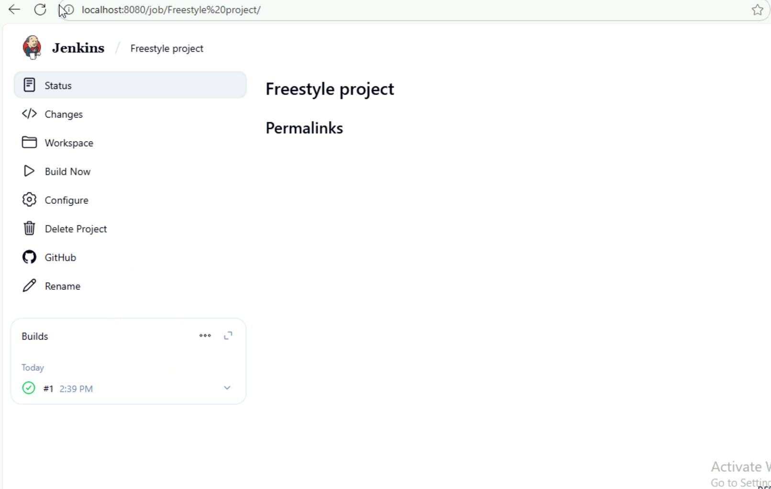
Deploying Git Project On Jenkins

Slide 9
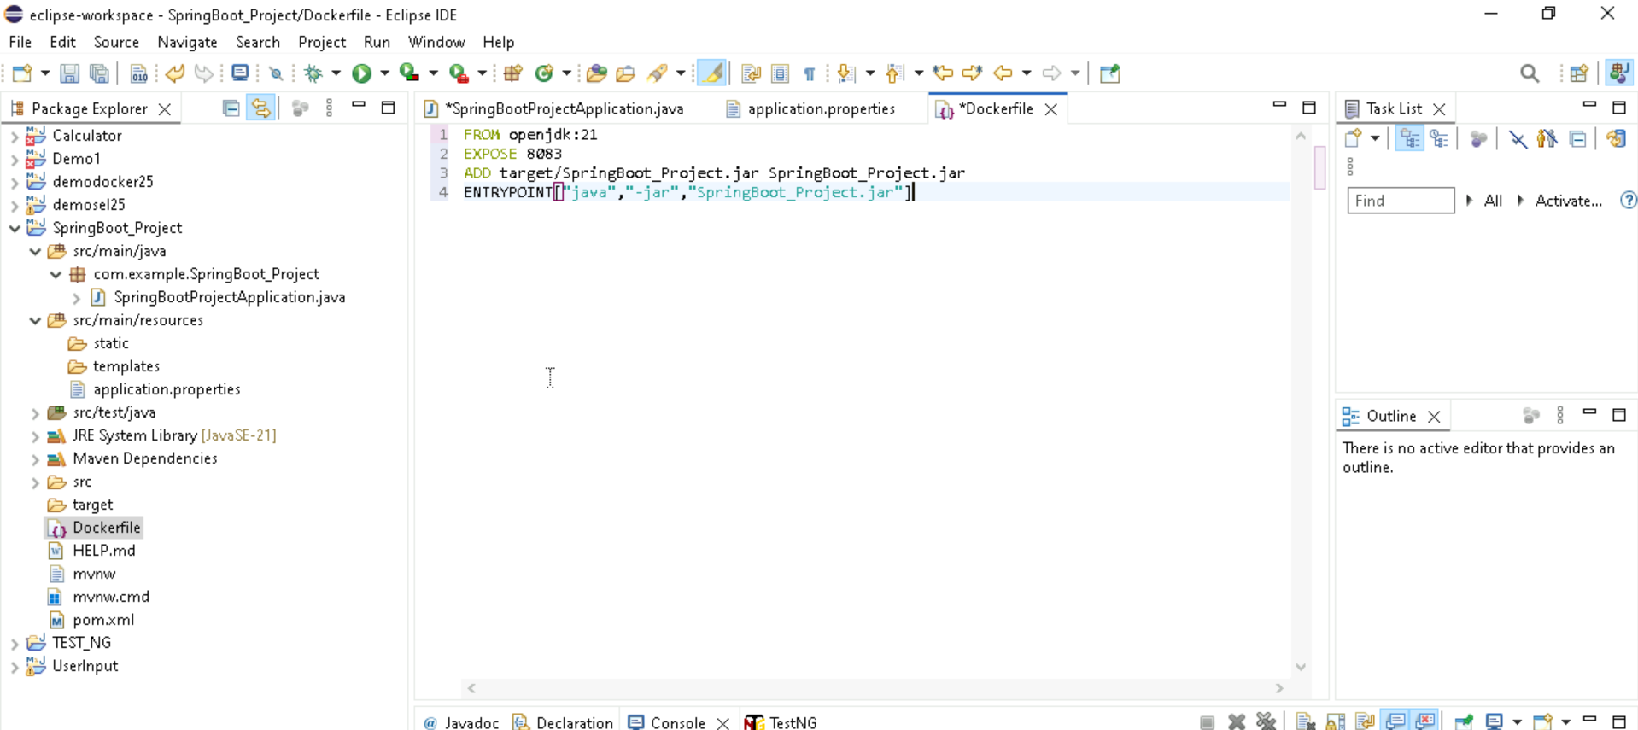
Creating a Docker File

Slide 10
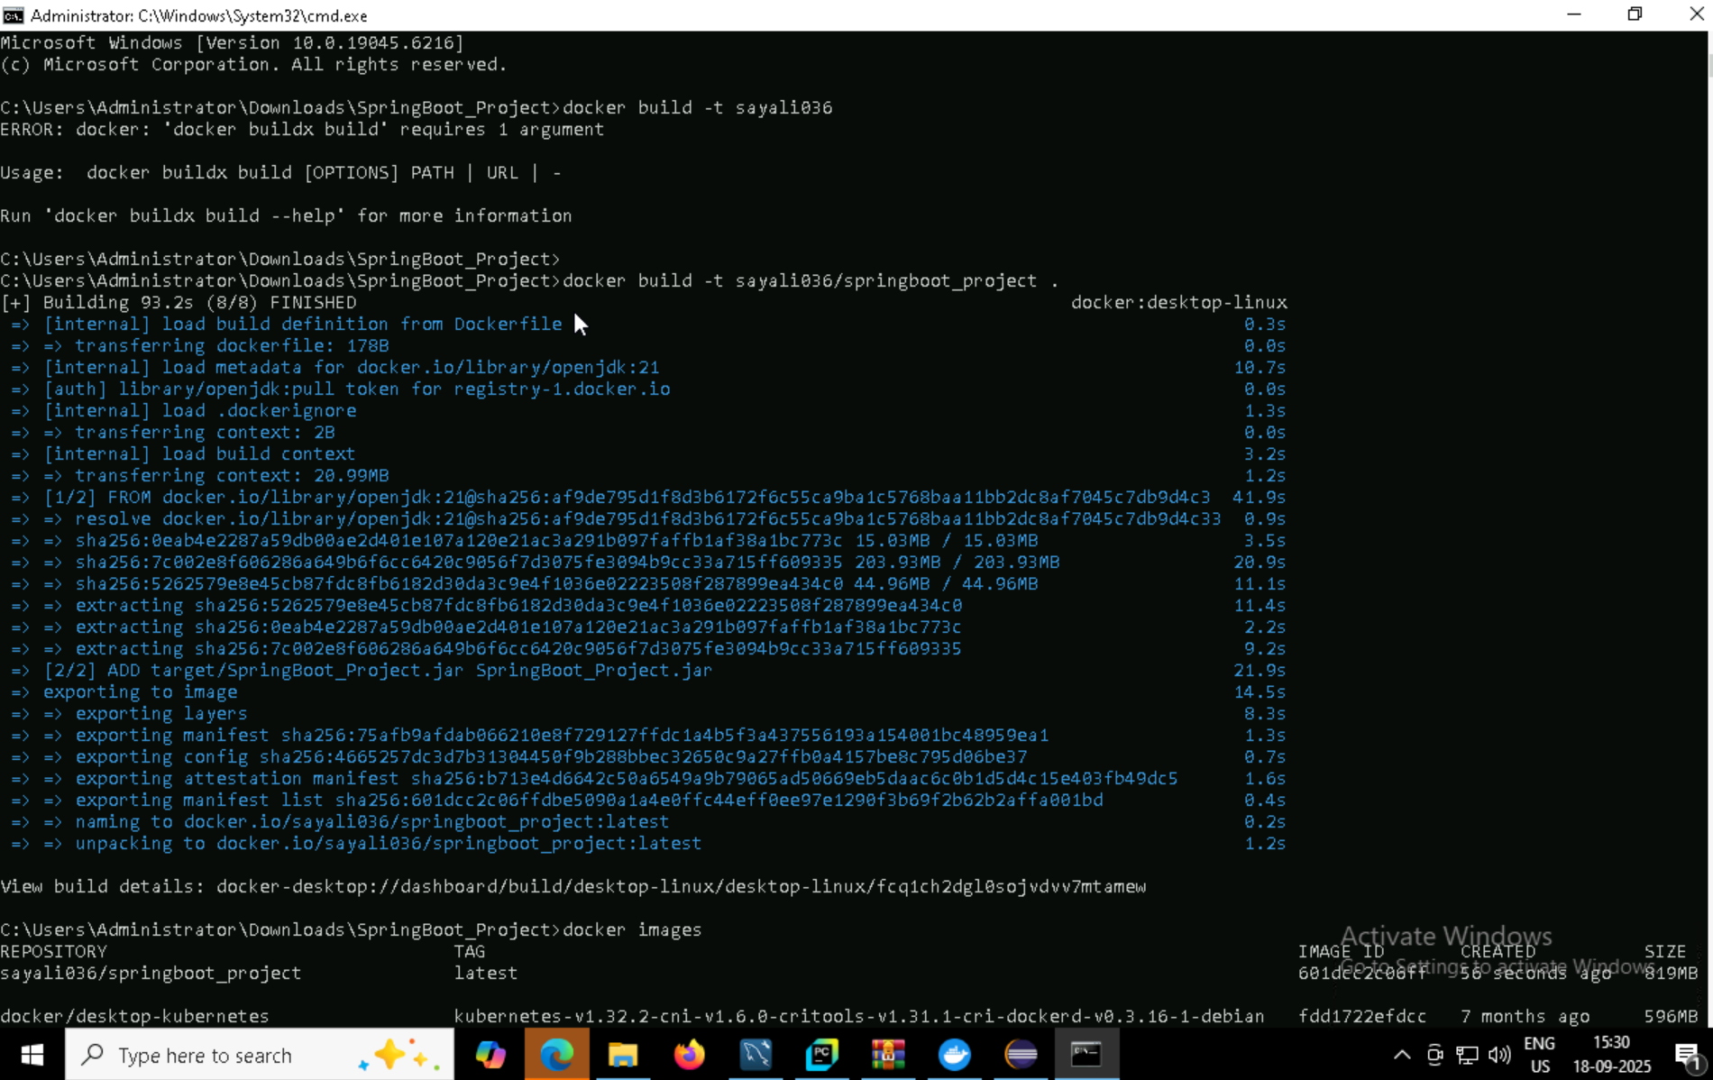
Generating Docker Image Via Command Prompt

Slide 11
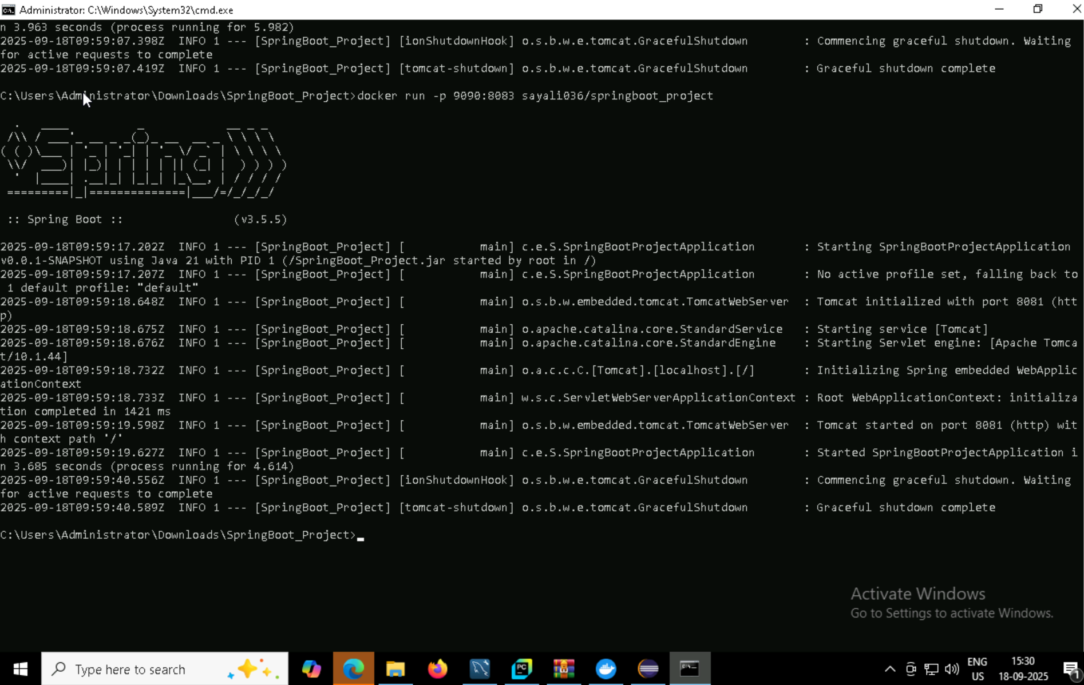
Running Docker

Slide 12
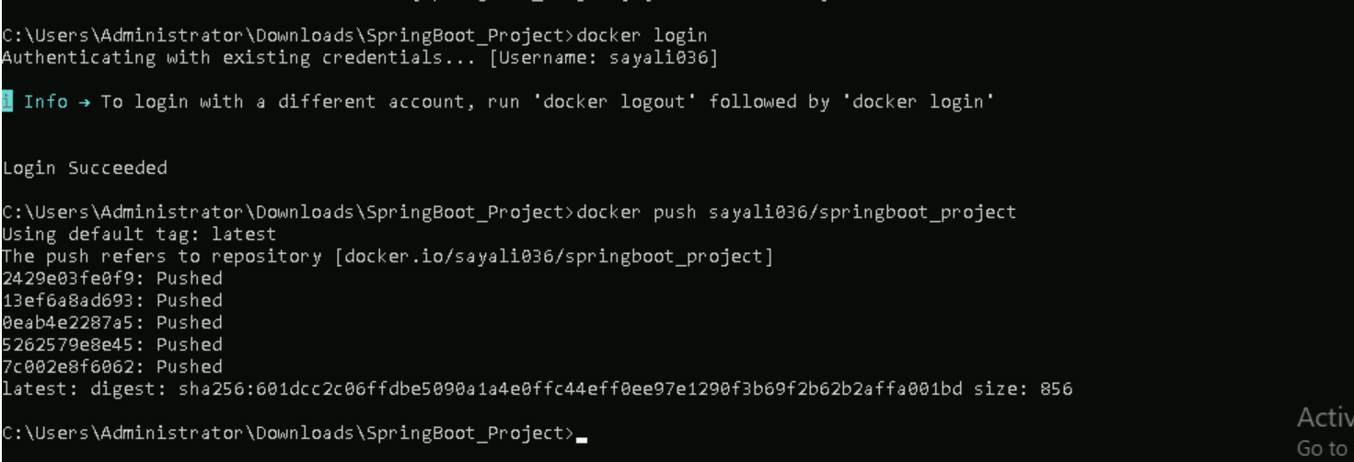
Docker Login

Slide 13
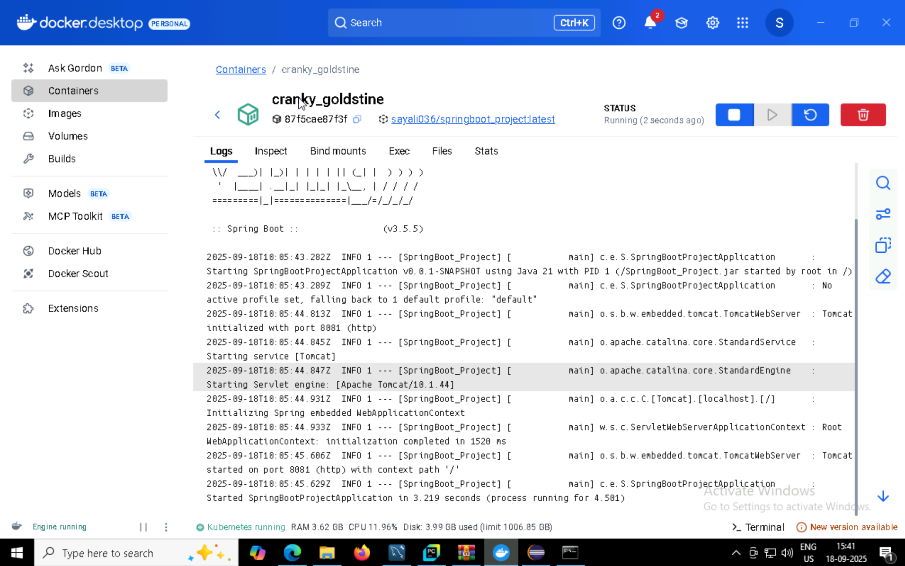
Generating Image On Docker

Slide 14
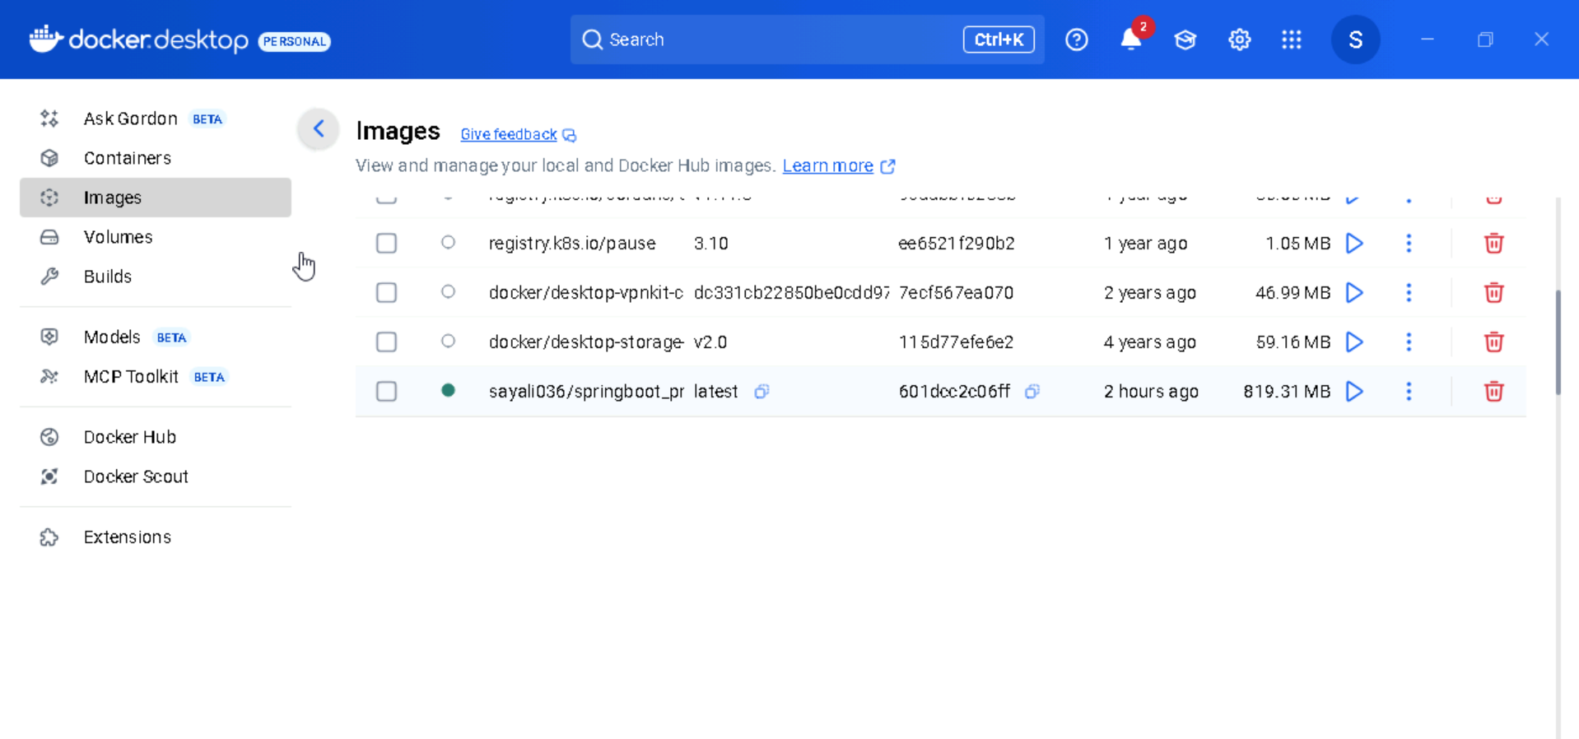
Image Generated

Slide 15

Thank You

